Slide 1
LabChat
Hanna Schulze, Oliver Wagner
Cloud Computing WS 18/19

Slide 2
LabChat
Agenda
Sequence Diagram
Component Diagram
Mockups
Lesson learnt
Node Modules, jQuery Plugins etc.
Features
Live Demo
Hanna Schulze, Oliver Wagner //Cloud Computing WS 18/19

Slide 3
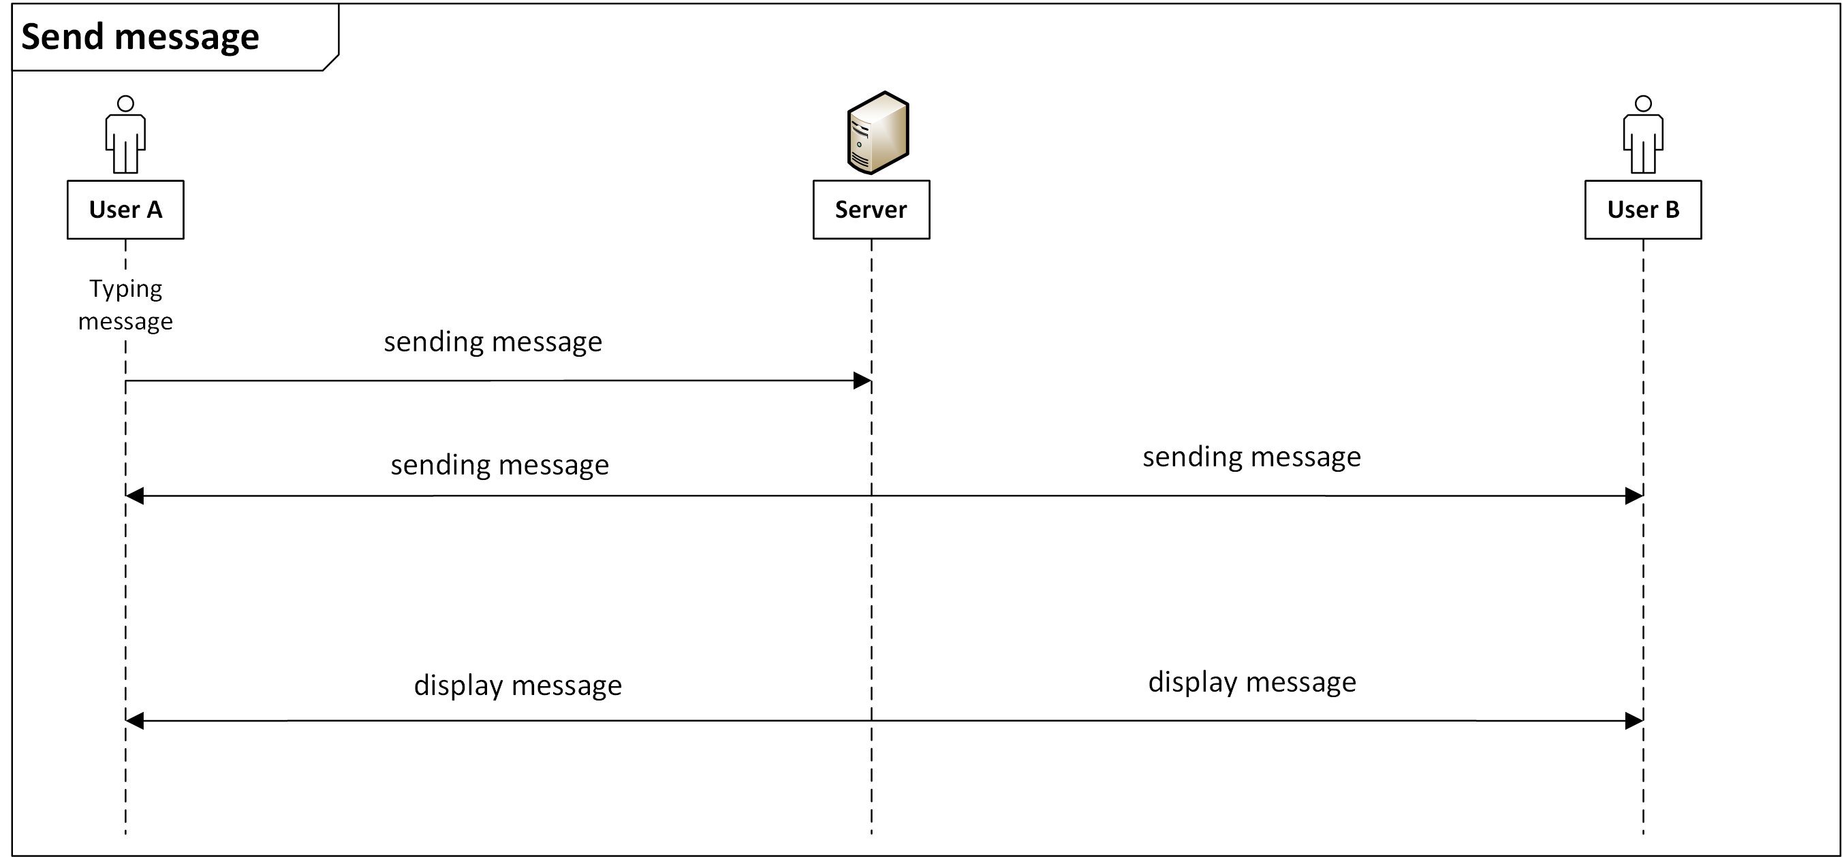
LabChat
Sequence Diagram
Hanna Schulze, Oliver Wagner //Cloud Computing WS 18/19

Slide 4
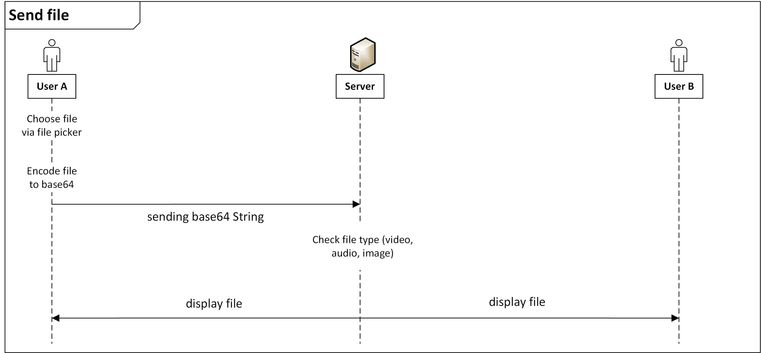
LabChat
Sequence Diagram
Hanna Schulze, Oliver Wagner //Cloud Computing WS 18/19

Slide 5
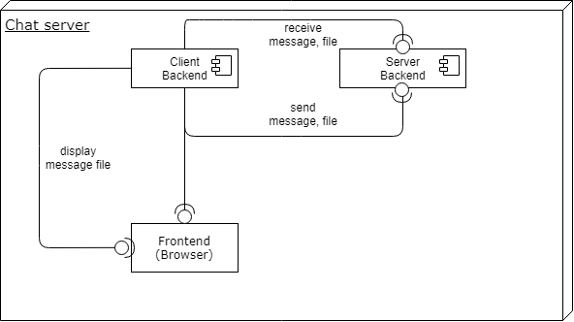
LabChat
Component Diagram
Hanna Schulze, Oliver Wagner //Cloud Computing WS 18/19

Slide 6
LabChat
Lesson learnt
Understanding the basics and functionalities of socket.io and express (sending information from the server to the client and back)
Working with Nodejs, jQuery and Bootstrap
Dealing with files and base64-encoding
Hanna Schulze, Oliver Wagner //Cloud Computing WS 18/19

Slide 7
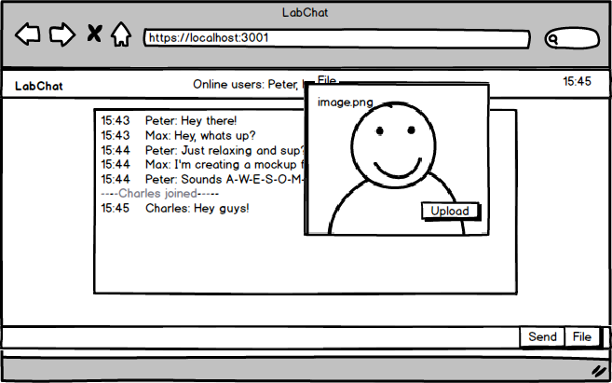
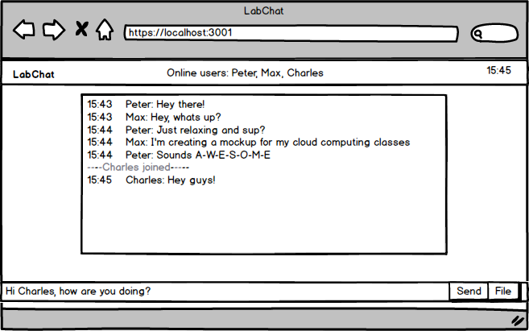
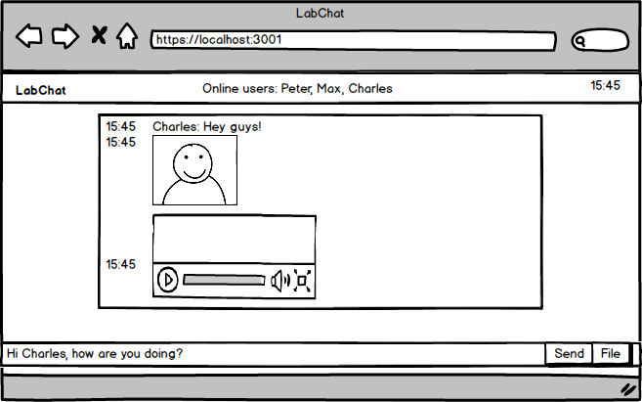
LabChat
Mockups
Hanna Schulze, Oliver Wagner //Cloud Computing WS 18/19

Slide 8
LabChat
Node Modules
express https://www.npmjs.com/package/express
dateformat https://www.npmjs.com/package/dateformat
fs https://nodejs.org/api/fs.html
https https://nodejs.org/api/https.html
socket.io https://socket.io
Hanna Schulze, Oliver Wagner //Cloud Computing WS 18/19

Slide 9
LabChat
Frameworks & jQuery Plugins
Bootstrap https://getbootstrap.com/
Fontawesome https://fontawesome.com/
CSS Emoticons https://os.alfajango.com/css-emoticons/
Hanna Schulze, Oliver Wagner //Cloud Computing WS 18/19

Slide 10
LabChat
Live Demo
https://localhost:3001
Hanna Schulze, Oliver Wagner //Cloud Computing WS 18/19

